Slide 1

Grow with Exilir CAPITALS
Eshaan Kumar & Abhay Singh
1st July-2023

Slide 2

AGENDA
About Elixir Capitals
Investment Options Available
​Why Elixir
Governance
​Business Model

Slide 3
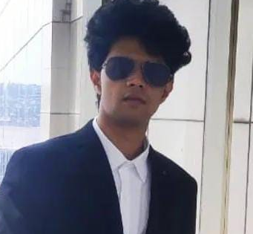
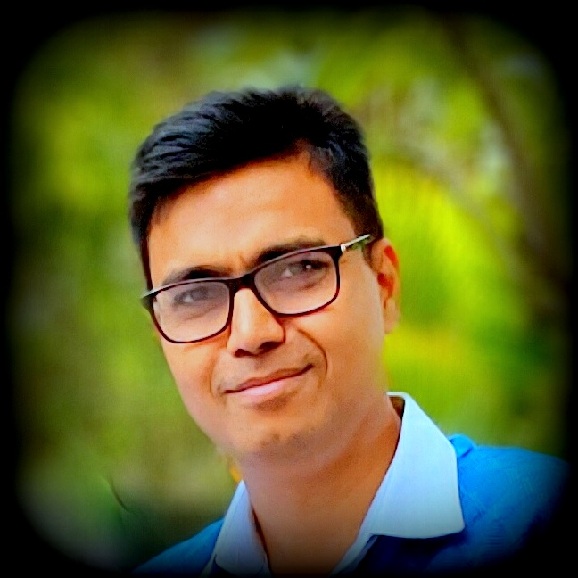
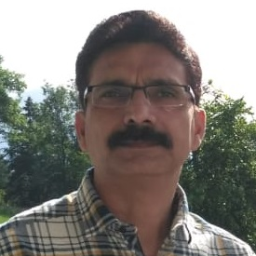
MEET OUR TEAM
Eshaan Kumar
Abhay Singh
Devendra Kumar
Director-Strategy
Director-Business Relations
Director-Logistics

Slide 4

ELIXIR’S MISSION
Grow clients’ investments by maximizing profits & manage losses using the best portfolio management strategies

Slide 5






Investment options
Bank Saving: 3% to 6%
Risk: Nil
Property: Up To 15%
Risk: Low
Fixed Deposit: 6% to 9%
Risk: Nil
Mutual Fund: 8% to12%
Risk: Moderate
Our Strategy is 24% to 36% & beyond
Risk-Very Low
Stocks Unlimited Gain
Risk: High

Slide 6

WHY ELIXIR
With the help of an extensive study of the stock market and its various parameters, whilst deploying fundamental, technical, and quantitative analysis, Elixir has developed a strategy to produce consistently high returns at very low risk

Slide 7
WHY ELIXIR
Tested Strategy on multiple paid and free tools and received 34% (Average Annualized) profit at an 84.5%-win rate These tools are not capable to cater our complete strategy.
Manually tested our elaborate strategy on virtual capital over1000 Days, our win rate is 97.6% & profit was 54% (Average Annualized)
Handled 5 investments and generated returns of more than 5% monthly

Slide 8
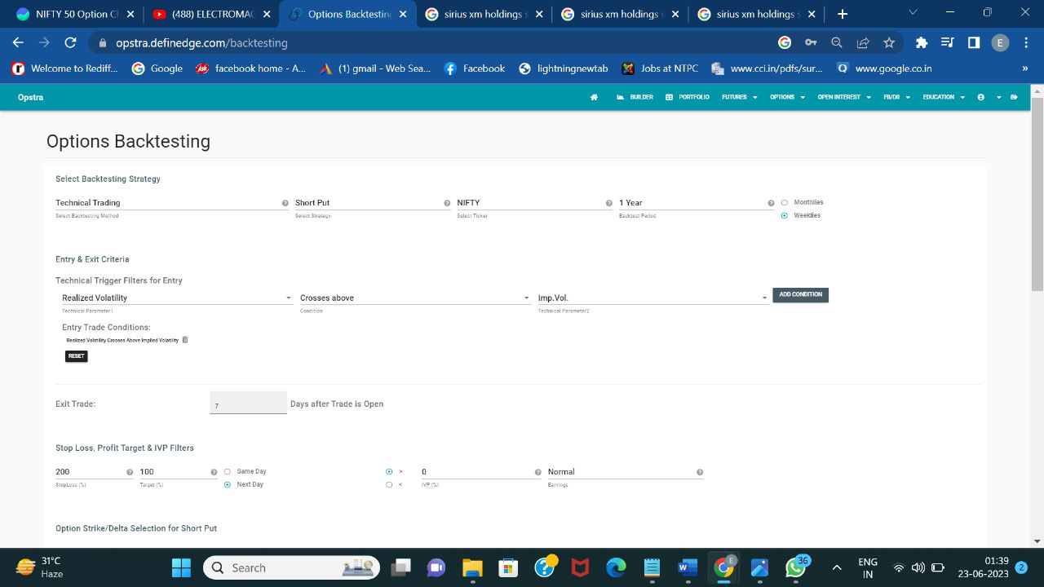
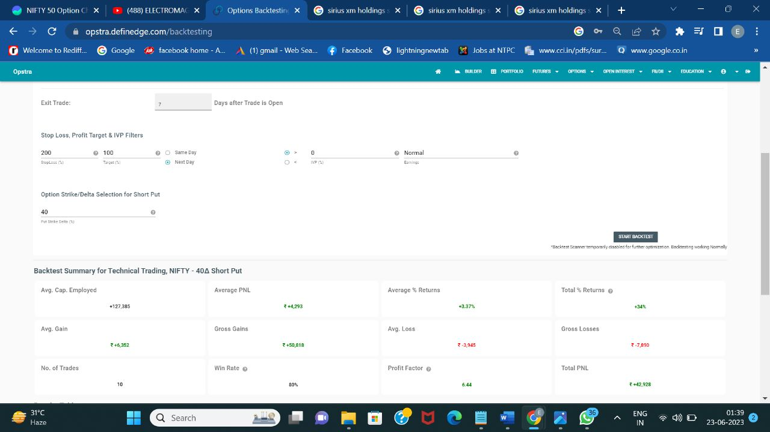
WHY ELIXIR
Strategy Testing Results: Profit-34% & Win Rate-80%

Slide 9
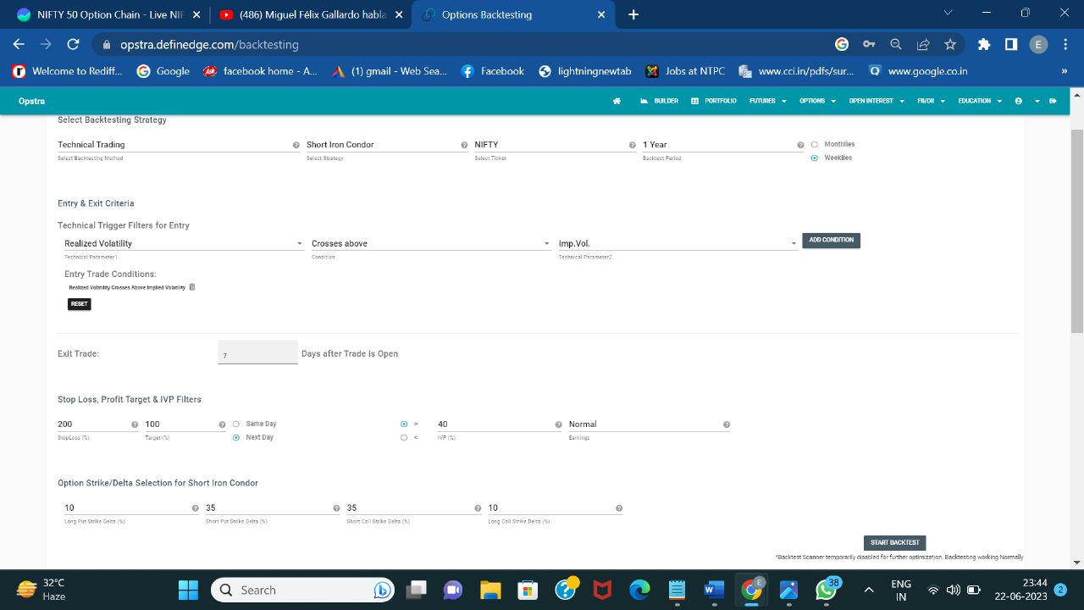
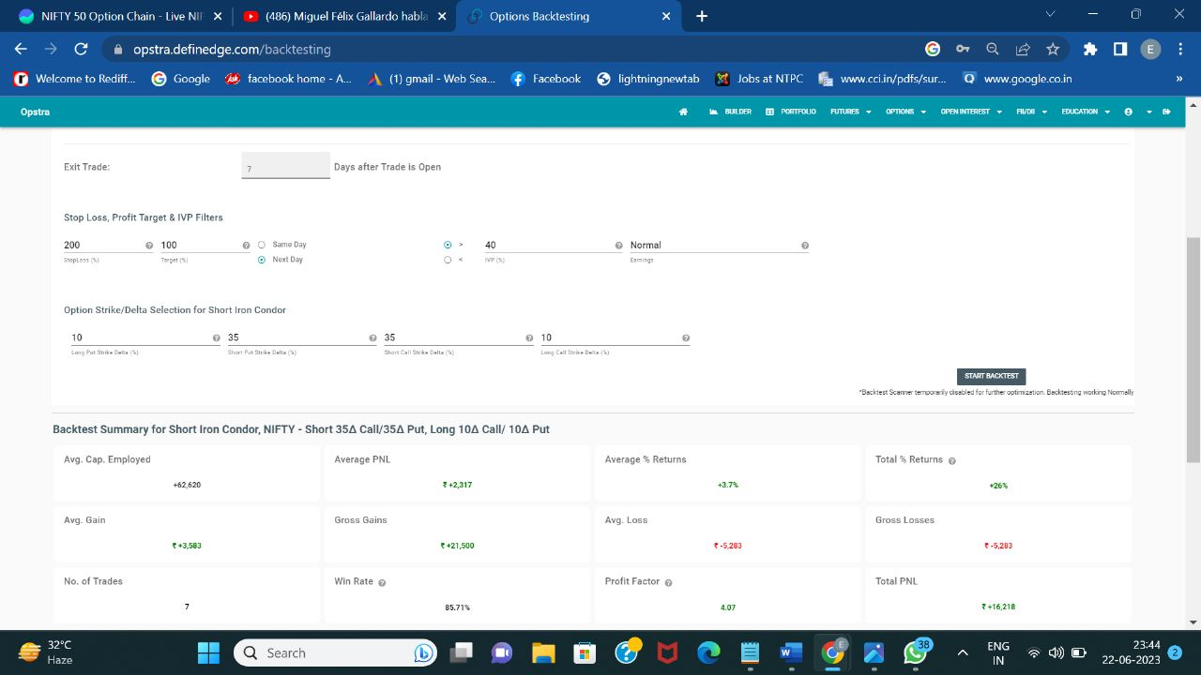
WHY ELIXIR
Strategy Testing Results: Profit-34% & Win Rate-80%

Slide 10
WHY ELIXIR
Real Results
In real-time Strategy never failed
9% monthly return for a 3-month period to a Lawyer
9.3% monthly return in the USA market for a 3-month period to a relative
8.5% monthly return to a Banker
7.8 % monthly return to a college student
More than 10% monthly return to a Family

Slide 11

Governance
The monthly transaction report (PnL) will be shared with all the customers
AUM & Overall Profit will be shared, customers can calculate their own profit based on their stake in the AUM
Elixir will be available for query resolution & customer support
All customer data and investment details are confidential
The strategy utilized by Elixir Capitals will remain CONFIDENTIAL

Slide 12

Business Model
PERIOD
It is recommended to maintain the capital with us for a period of 1 Year to notice the best results
PROFIT SHARING
Up to 1st % monthly profit will be given to the customer, Profits in excess of 1% monthly will be equally divided
Ex 5% monthly profit- Client will receive 1+ half of remainder = 3%
Elixir will receive the rest = 2%
Settlement
The profits will be settled in 3 month’s period
If the client wishes to keep profits with Elixir then the effect of compounding will further increase returns
Exit Load
If the client wishes to withdraw the capital [partially or fully] before 3 months, then 1% of the amount withdrawn will be deducted
Notice Period & Management Fees
The client needs to provide a notice period of a minimum of 1 week
0.02% Monthly Maintenance Fees will be applicable on AUM

Slide 13
RESPONSE
TO
Tradebook

Slide 14

ELIXIR’s Response to tradebook
We agree with equal partnership in Profits, Expenses & Losses with Tradebook
Tradebook will be responsible for Fundraising
Elixir will be responsible for the growth of the fund
After a thorough consultation with multiple authorities, it was identified that the cost of licensing and branding can be avoided up until an AUM of Rs 20 Cr
Once we achieve the above-mentioned AUM we can opt for licensing and branding

Slide 15
THANK YOU
Abhay Singh
abhayk007@gmail.com

